Slide 1
Game Analysis Using SQL
Mentorness Project 1
Presented By-
Shreya Rana

Slide 2
Overview
Queries
Conclusion

Slide 3
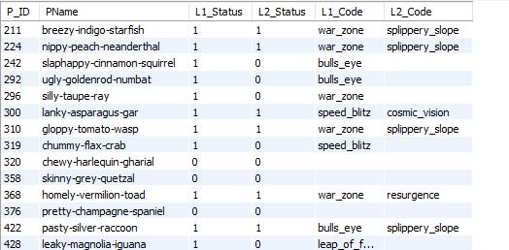
Dataset Description:
The dataset comprises two main tables: Player Details and Level Details.
Player Details Table
Player Details Table:
P_ID: Player ID
PName: Player Name
L1_status: Level 1 Status
L2_status: Level 2 Status
L1_code: System-generated Level 1 Code
L2_code: System-generated Level 2 Code

Slide 4
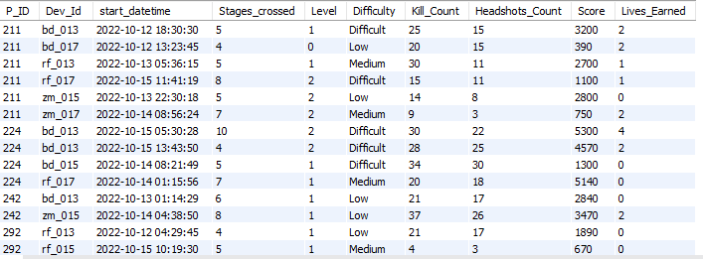
Level Details
Level Details Table:
P_ID: Player ID
Dev_ID: Device ID
start_time: Start Time
stages_crossed: Stages Crossed
level: Game Level
difficulty: Difficulty Level
kill_count: Kill Count
headshots_count: Headshots Count
score: Player Score
lives_earned: Extra Lives Earned

Slide 5
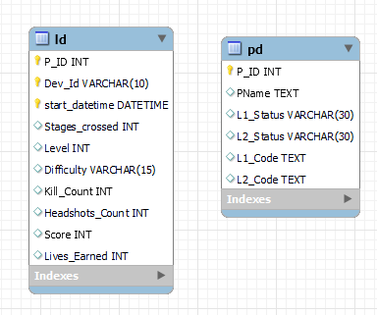
ER Diagram

Slide 6
DATA QUERIES

Slide 7
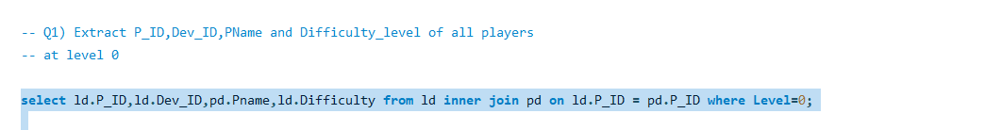
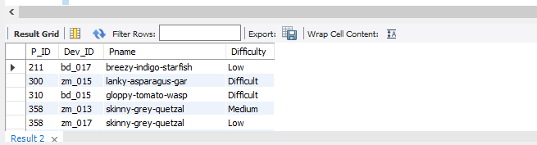

Slide 8
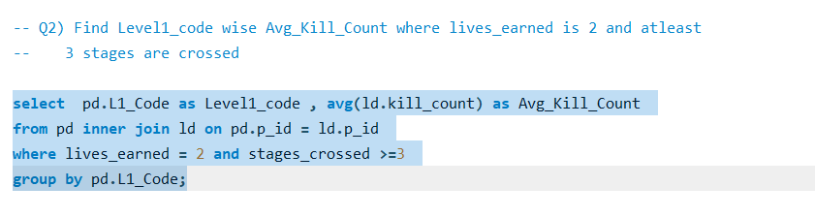
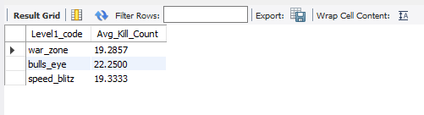

Slide 9
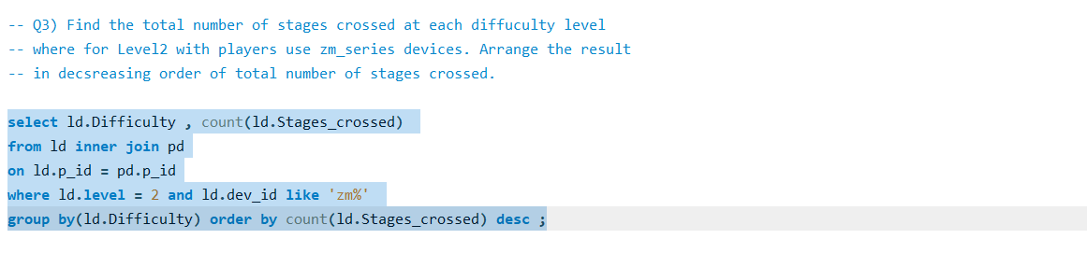
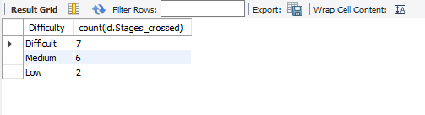

Slide 10
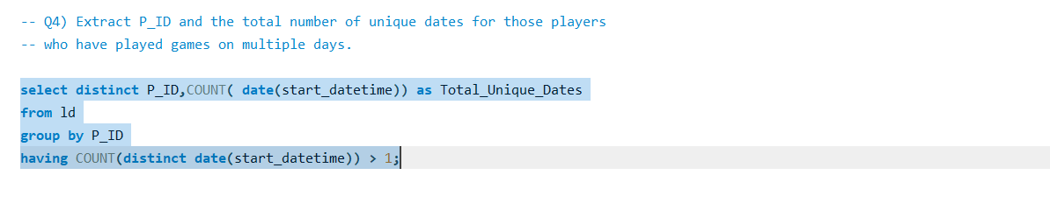
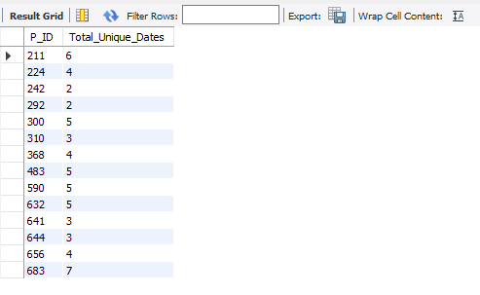

Slide 11
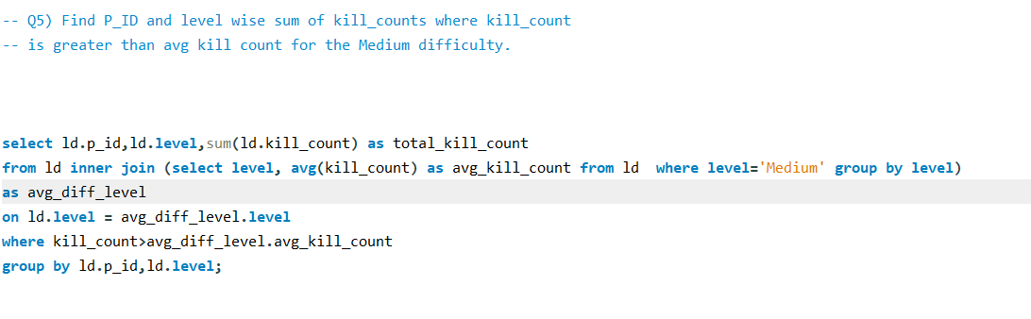
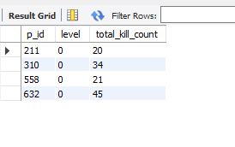

Slide 12
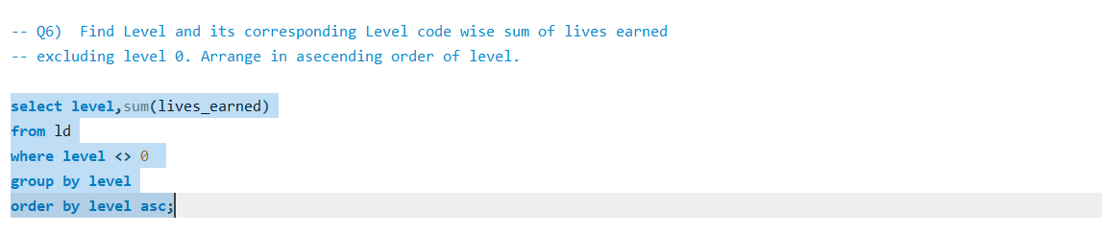
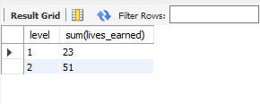

Slide 13
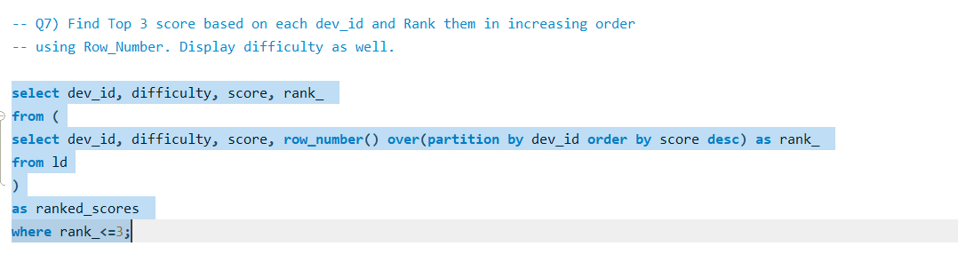
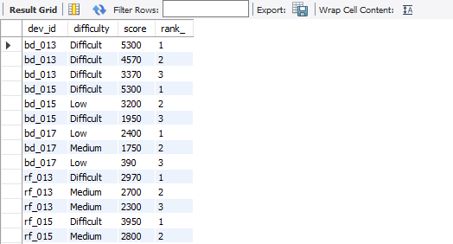

Slide 14
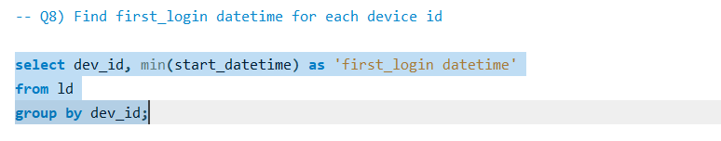
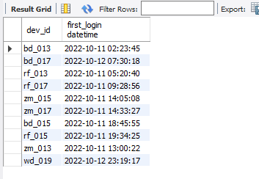

Slide 15
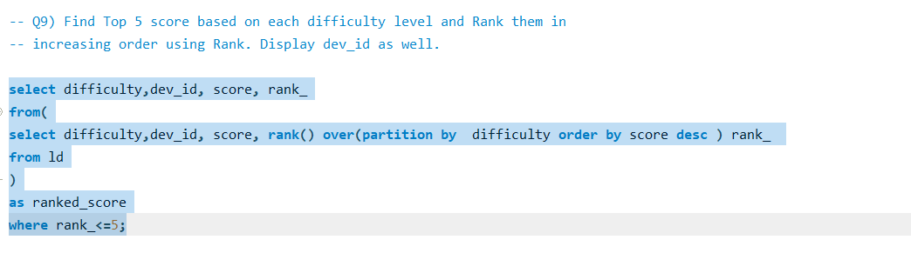
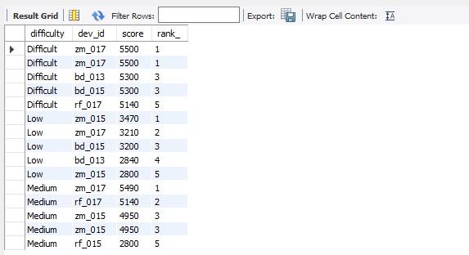

Slide 16
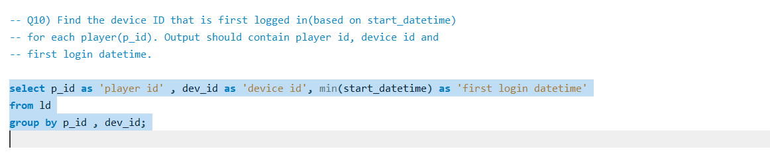
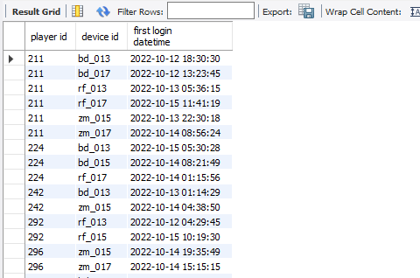

Slide 17
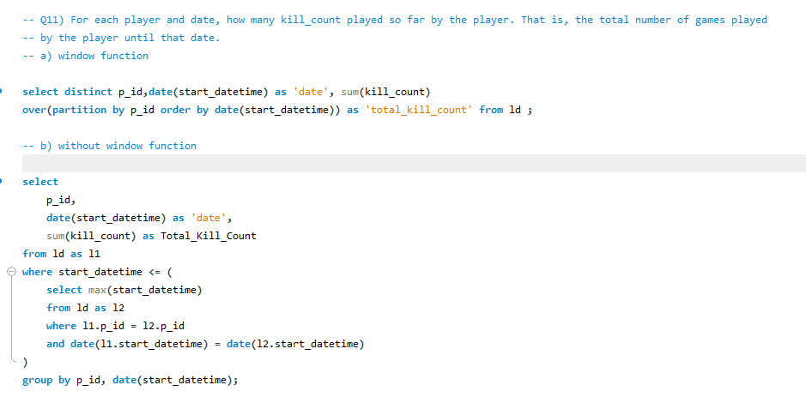

Slide 18
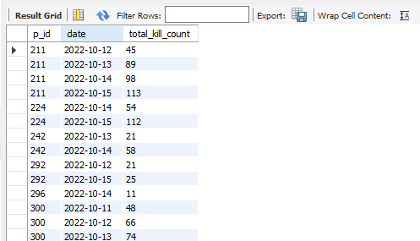
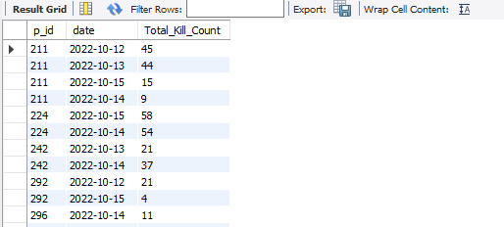
11.b
11.a

Slide 19
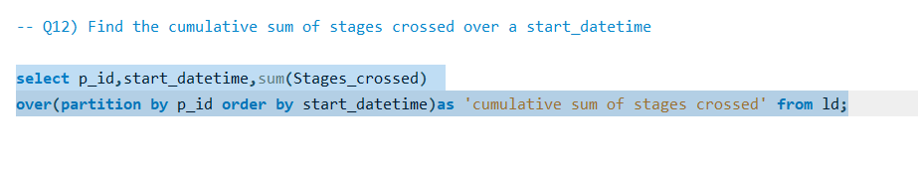
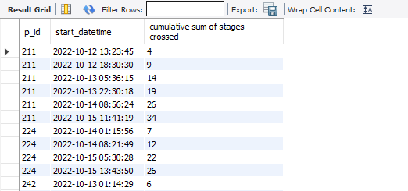

Slide 20
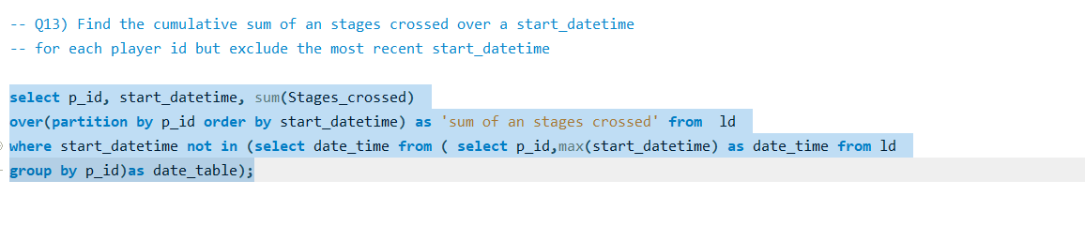
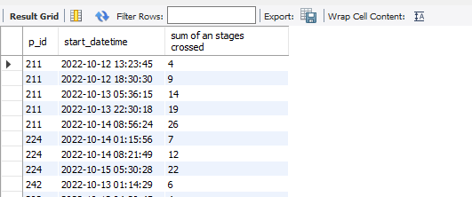

Slide 21
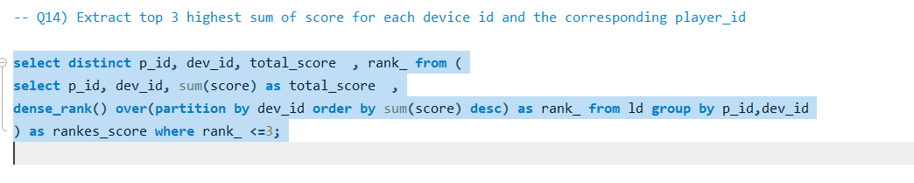
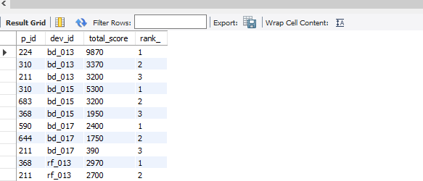

Slide 22
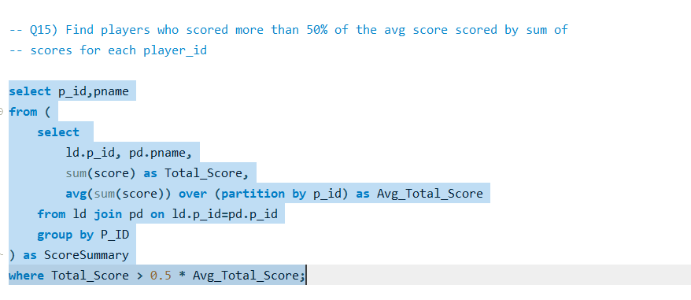
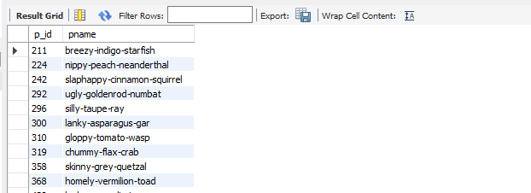

Slide 23
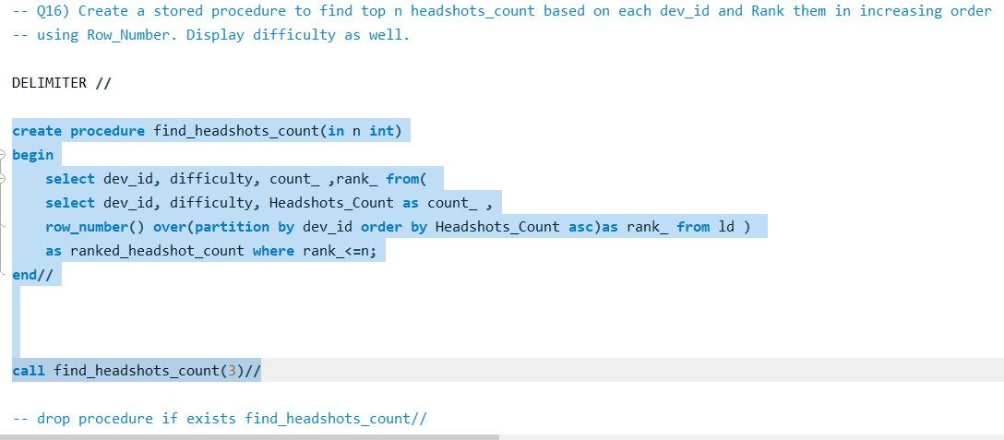
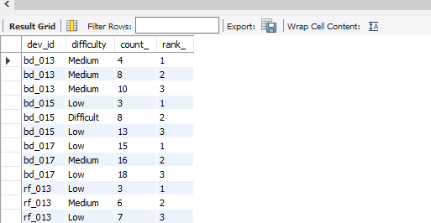

Slide 24
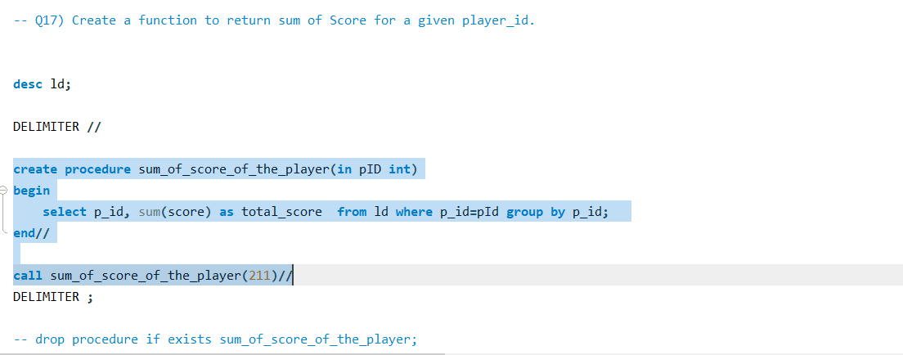
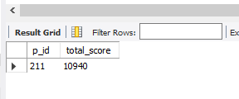

Slide 25
Conclusion:
In this analysis of gaming behavior, we explored player performance across three levels and three difficulty tiers. By dissecting player actions such as kill counts and stage progression, we unveiled patterns indicative of player engagement and skill development. Through careful examination of player demographics and device usage, we identified trends in gameplay preferences and user engagement. Our findings highlight standout performances, including top scores and headshot counts, while also revealing areas for potential optimization in game mechanics. Overall, this analysis provides valuable insights into player behavior and performance, laying the groundwork for future enhancements to the gaming experience.
In this analysis, I have learnt about complex query structures, windows function ( like rank(), dense_rank(), row_number()), Stored procedure and how to create it and call it.

Slide 26
Thank You

